Slide 1
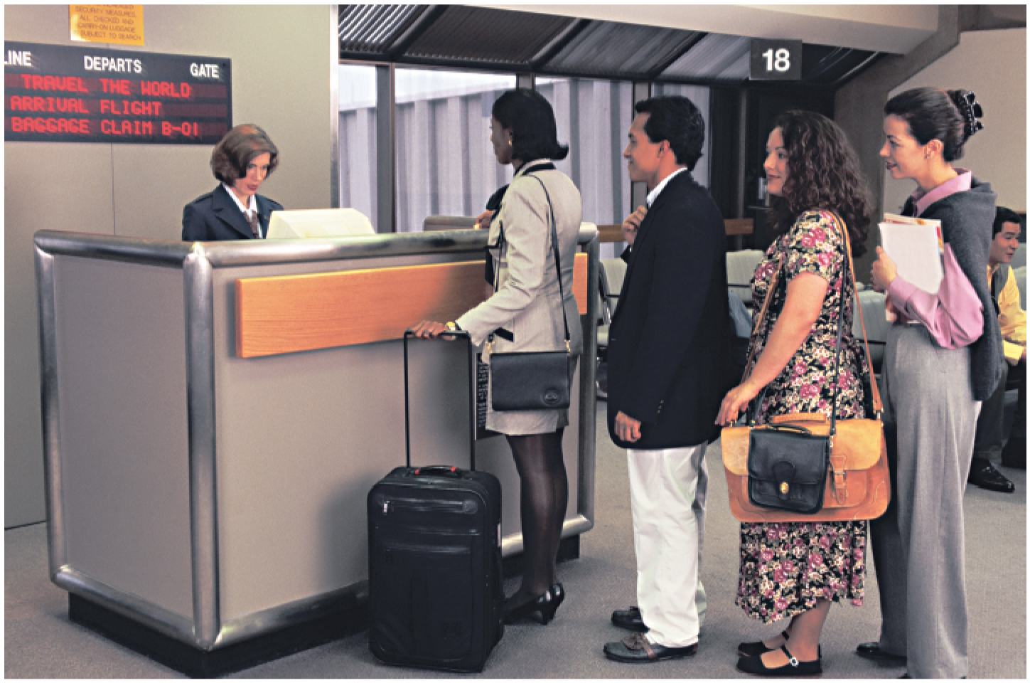
Queues

Slide 2
Queues
A queue is a list of elements in which items are inserted at one end of the queue and deleted from the other end of the queue
The end at which elements are inserted is called the REAR
The end from which elements are deleted is called the FRONT
A queue is also called a First-In-First-Out (FIFO) list
The first element to be inserted in the queue is the first one to be deleted

Slide 3
Operations on queues
Insert: it refers to the addition of an item in the queue
Deletion: it refers to the deletion of an item from the queue

Slide 4
Implementing queues
Queues can be implemented using:
Array
or
Linked list

Slide 5
Implementing a queue using an Array
Use array only if you are sure about the maximum number of elements in the queue
Declare an array to store the elements in the queue
Example: int queue_array [5];
In addition, declare to integer variables, FRONT and REAR to keep track of the front and rear index positions of the queue respectively
The value of FRONT and REAR is set to -1 to indicate that the queue is empty

Slide 6
Implementing insert and delete operations on a queue
Insertion algorithm
If the queue is empty:
Set FRONT=0
Increment REAR by 1
Store element at index position REAR in the array

Slide 7
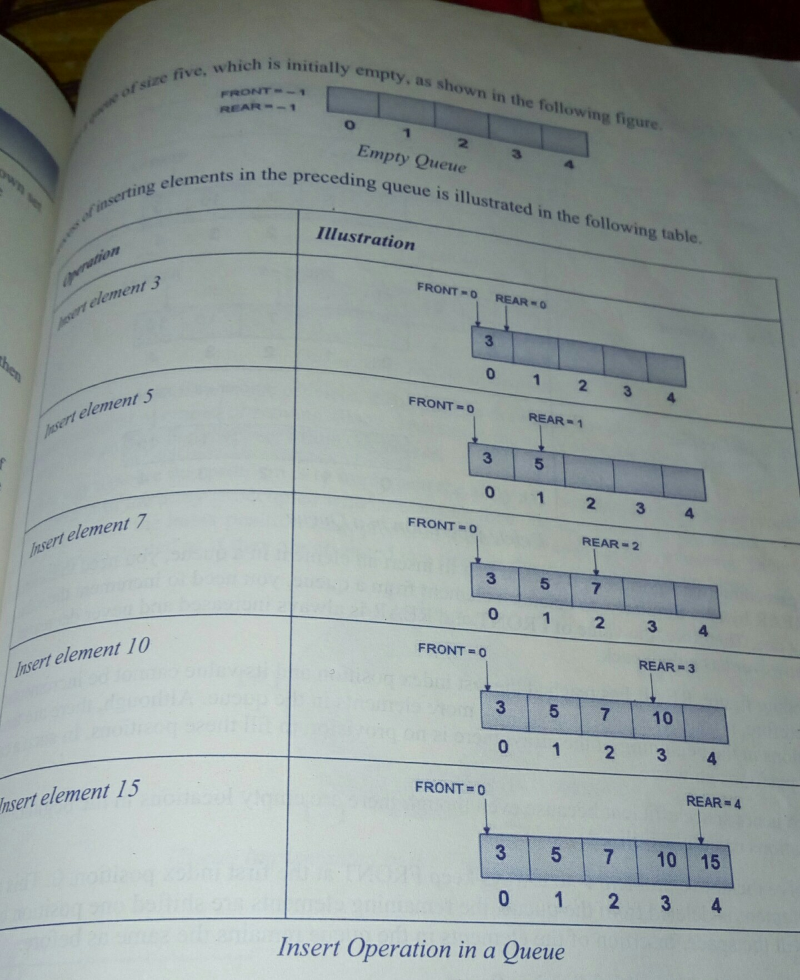

Slide 8
Cont…
Deletion algorithm
Retrieve the element at index FRONT
Increment FRONT by 1

Slide 9
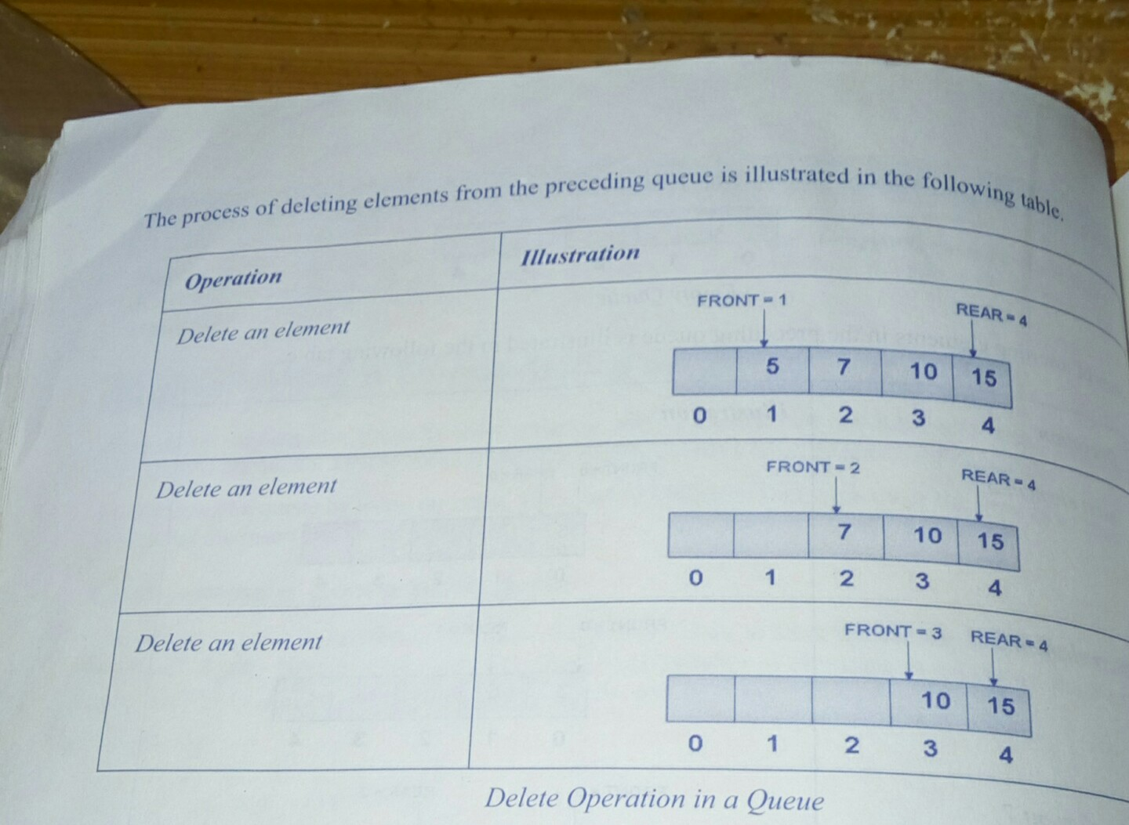

Slide 10
Implementing array as a circular array
When an element is inserted in a circular array, the value of REAR is incremented by one.
However, if REAR is at the last index position, you can reinitialize the value of REAR to zero and start inserting elements from the beginning, provided there is space at the beginning of the list.
Overflow occurs when one of the following is true:
FRONT=0 and REAR= last index position
FRONT=REAR+1

Slide 11
Insert algorithm
If the queue is full:
Display “Queue overflow”
Exit
If the queue is empty (If FRONT=-1):
Set FRONT=0
Set REAR=0
Go to step 5
If REAR is at the last index position:
Set REAR=0 // Set REAR to the first index position
Go to step 5
Increment REAR by 1
Queue [REAR] = element

Slide 12
Delete operation
To delete an element from a circular queue, the value of FRONT is incremented by one.
However, if the element to be deleted is present at the last index position, then the value of front is set to zero.
The underflow condition occurs when FRONT=REAR=-1

Slide 13
Deletion Algorithm
If the queue is empty: // if FRONT = -1
Display “Queue underflow”
Exit
If there is only one element in the queue: // If FRONT=REAR
Set FRONT= -1
Set REAR= -1
Exit
If FRONT is at the last index position:
Set FRONT = 0 // Set FRONT to the first index position
Exit
Increment FRONT by 1

Slide 14
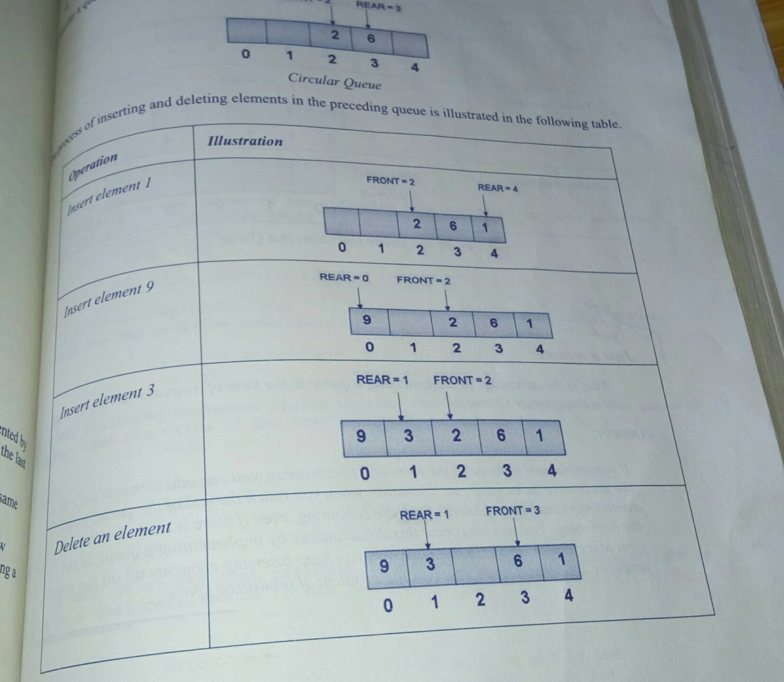

Slide 15
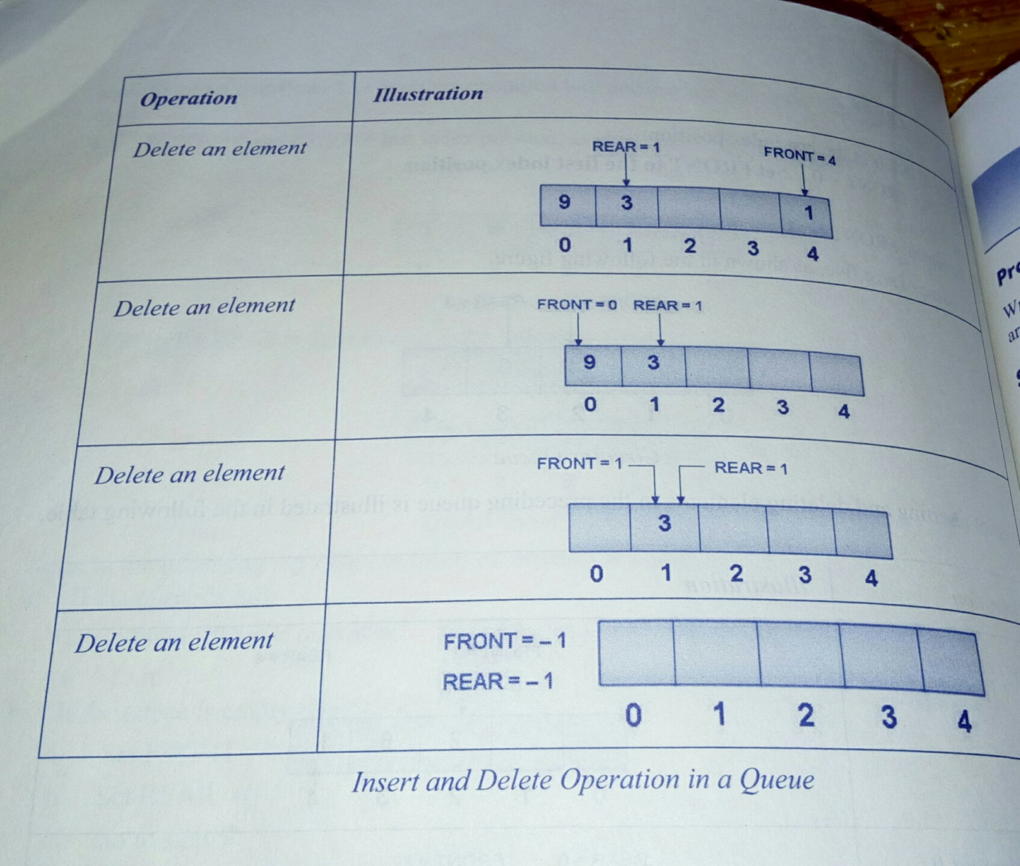

Slide 16
Implementing a queue using Linked list
Useful when the size of the queue is not known in advance
A queue implemented in the form of a linked list is known as a linked queue

Slide 17
Inserting an element in a linked queue
An element is always inserted at the rear end of the queue
Therefore, you need to insert a node at the rear end of a linked queue

Slide 18
Insertion algorithm
Allocate memory for the new node
Assign value to the data field of the new node
Make the next field of the new node point to NULL
If the queue is empty, execute the following steps:
Make FRONT point to the new node
Make REAR point to the new node
Exit
Make the next field of REAR point to the new node
Make REAR point to the new node

Slide 19
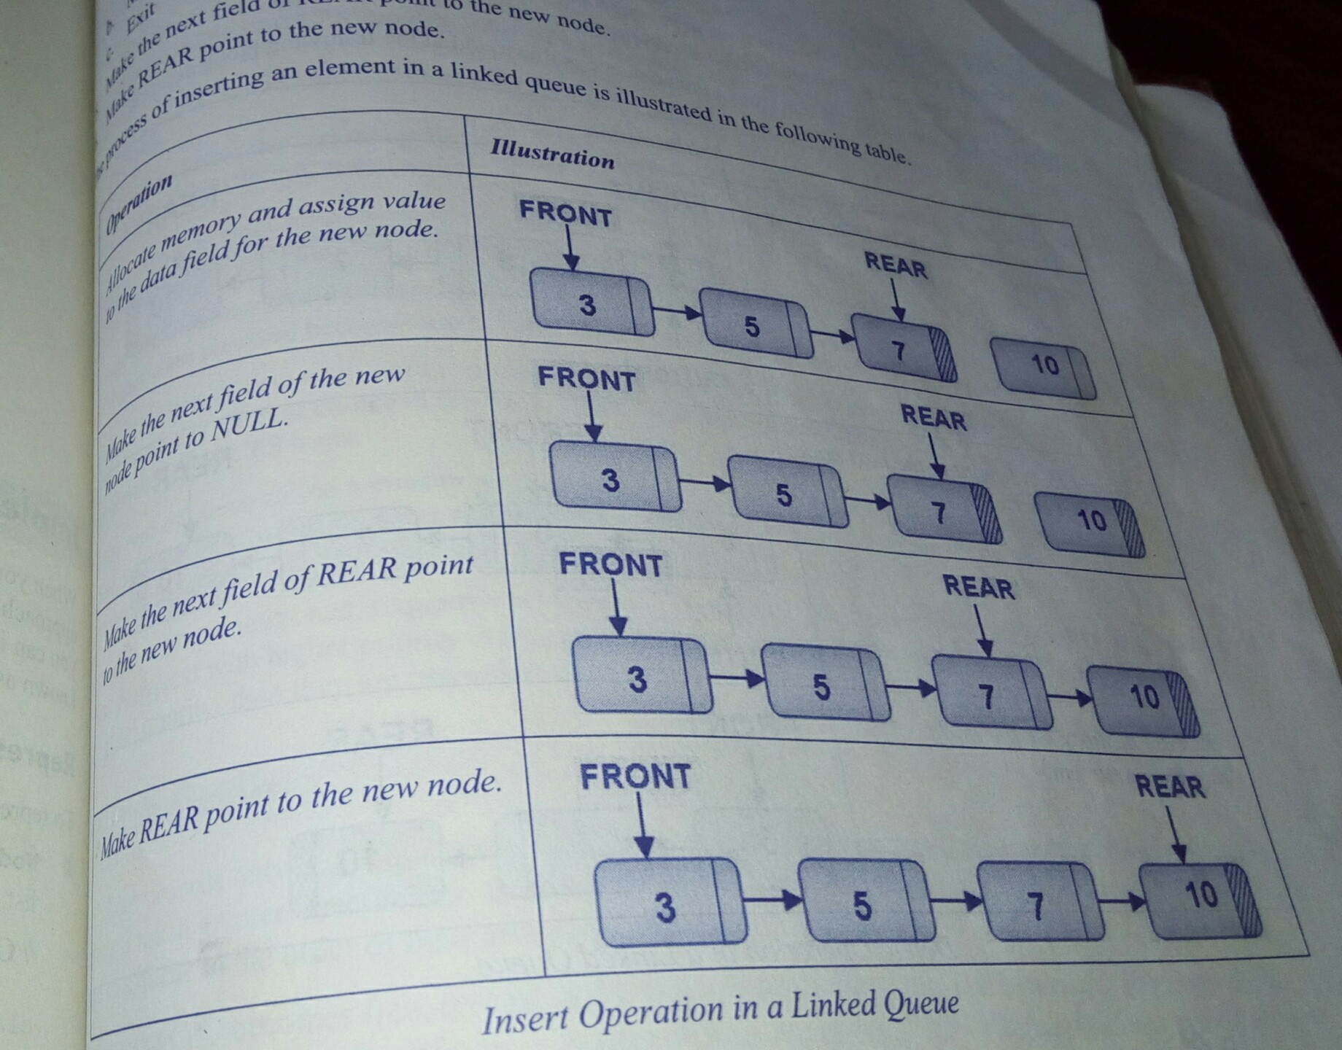

Slide 20
Deleting an element from a Linked queue
An element is always deleted from the end of a queue.
Therefore you need to delete a node from the front end of the linked queue

Slide 21
Deletion Algorithm
If the queue is empty:// FRONT=NULL
Display “Queue empty”
Exit
Mark the node marked FRONT as current
Make FRONT point to the next node in the sequence
Release memory for the node marked as current

Slide 22
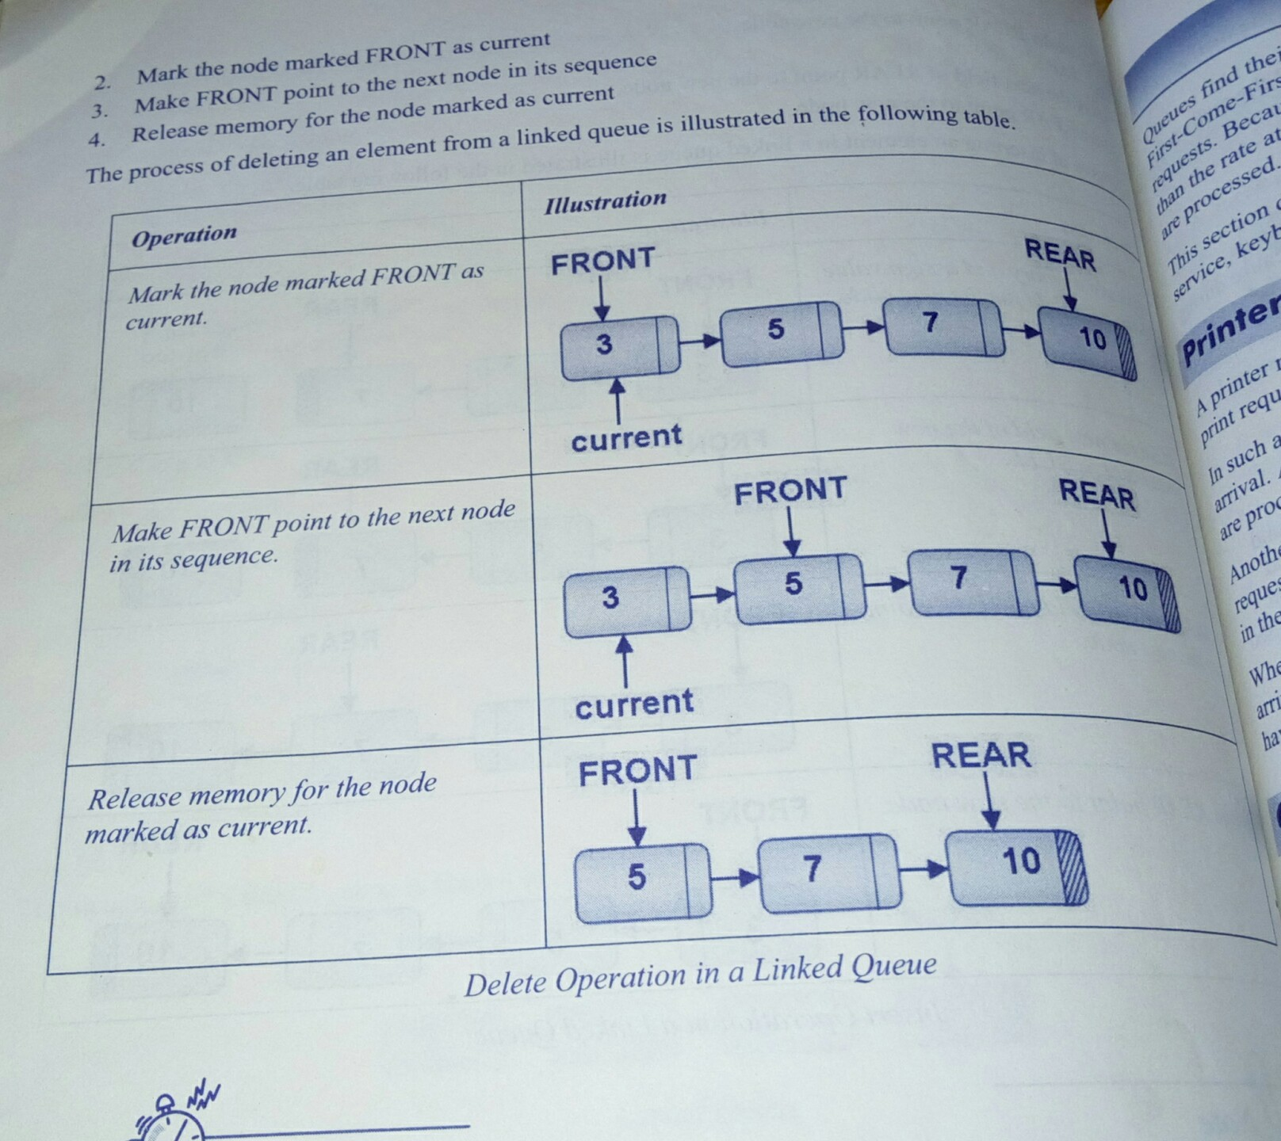

Slide 23
Applications of queue
Printer Spooling
CPU Scheduling
Mail Service
Keyboard Buffering
Elevator

